Slide 1
Tkinter
Develop a GUI application

Slide 2
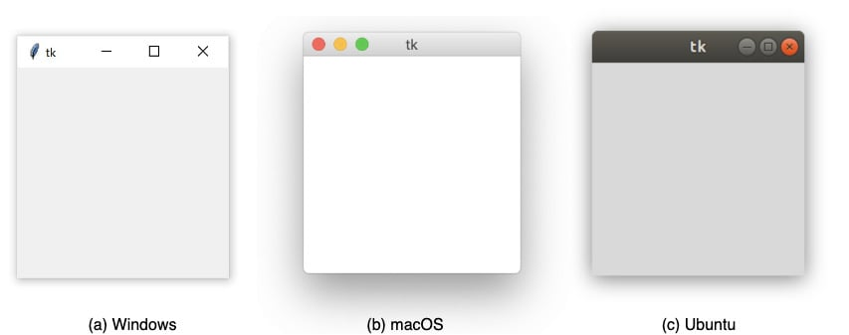
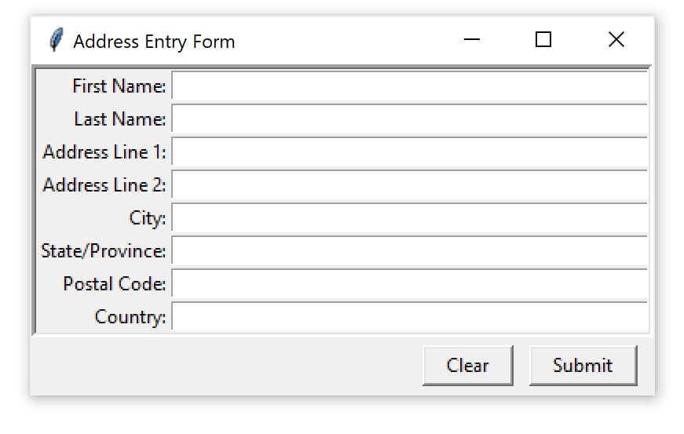
Tkinter
Characteristic
A Python standard library as GUI framework
Cross-platform, same code works on Windows, macOS, and Linux
Using native operating system elements
Lightweight and relatively painless to use compared to other frameworks
Look outdated
Coding structure
Import library
Create a window
Create widgets (button, label, entry / text, frame)
Control layout with geometry managers (pack, place, grid)
Make interactive by associating function (bind, command)
Initiate window

Slide 3
Coding Structure
Import library
import tkinter as tk
Create a window
window = tk.Tk()
Create widgets
lbl_greeting = tk.Label(text=‘Hello GUI’)
Control layout with geometry managers
lbl_greeting.pack()
Make interactive by associating function
Initiate window
window.mainloop()
import tkinter as tk
# create window
window = tk.Tk()
#create widget
lbl_greeting = tk.Label(text='Hello GUI')
#control layout to locate widgets (pack 在可以完整呈現元件的前提下，讓視窗盡量縮小)
lbl_greeting.pack()
#initiate window
window.mainloop()

Slide 4
Widgets 元件
元件類別 | 說明 | 簡寫 | 命名範例 | 常用屬性
Label | 顯示文字或圖像 | lbl | lbl_name | master, text, fg, bg, width, height, font, textvariable, image, relief, justify
Button | 上面有文字，點擊後會執行動作的按鈕 | btn | btn_submit | master, text, fg, bg, width, height, image, command
Entry | 輸入一行文字的輸入框 | ent | ent_age | master, fg, bg, width, height, state, textvariable, show
Text | 輸入多行文字的輸入框 | txt | txt_notes | master, fg, bg, width, height
Frame | 把元件分組或是當作空白間距的矩形區域 | frm | frm_address | bg, , width, height, relief, borderwidth, master
Tkinter 顏色名稱: https://www.tcl.tk/man/tcl/TkCmd/colors.html

Slide 5


Lab# Widgets - Label
Create a window to display 3 labels as screen shoot (#29)
Explain label options in below code (#30)
import tkinter as tk
window = tk.Tk()
window.title('font display')
lbl = tk.Label(window,
text='tkinter practice \n font change',
bg='lightyellow',
fg='black',
width=15,
font='Helvetica 16 bold italic',
relief='raised',
justify='right')
lbl.pack()
window.mainloop()
Notes:
import tkinter as tk
# create window
window = tk.Tk()
#create widget (labels, button,..) – 元件
lbl_1 = tk.Label(text='GUI is great!')
lbl_2 = tk.Label(text='Python rocks!')
lbl_3 = tk.Label(text='Engage!')
#locate widgets by Geometry Managers – 幾何管理器
lbl_1.pack()
lbl_2.pack()
lbl_3.pack()
#initiate window
window.mainloop()

Slide 6


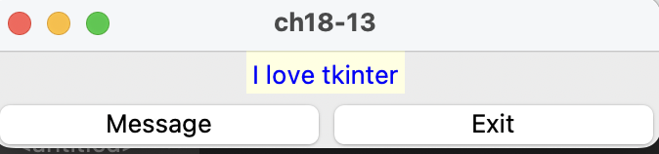
Widgets - Button
Change Button Foreground Color
Show message
import tkinter as tk
import random
#define action
def change_fg_color():
color = random.choice(['red', 'orange', 'yellow', 'blue', 'indigo', 'violet'])
button["fg"] = color
#create window
window = tk.Tk()
# add button
button = tk.Button(text='Click me', command=change_fg_color)
button.pack()
# initializing window
window.mainloop()
def showmsg():
label['text'] = 'I love tkinter'
label['bg'] = 'lightyellow'
label['fg'] = 'blue'
import tkinter as tk
window = tk.Tk()
label = tk.Label(window)
btn1 = tk.Button(window, text='Message', width=15, command=showmsg)
btn2 = tk.Button(window, text='Exit', width=15, command=window.destroy)
label.pack()
btn1.pack(side=tk.LEFT)
btn2.pack(side=tk.RIGHT)
window.mainloop()
Remark: button 的背景設定在macOS上沒有作用。這是作業系統本身的限制，不是Tkinter 的問題。
Notes:
？小提醒

Slide 7
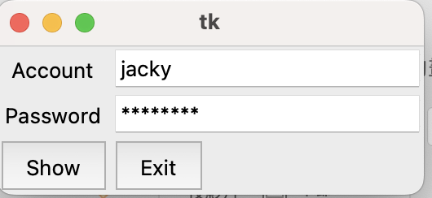

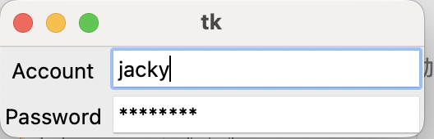
Widgets – Entry (1/2)
# entry allows one line text input
import tkinter as tk
# create window
window = tk.Tk()
#create widget (labels, button,..) – 元件
lbl = tk.Label(text="Name")
ent_name = tk.Entry()
#locate widgets by Geometry Managers
lbl.pack()
ent_name.pack()
#initiate window
window.mainloop()
import tkinter as tk
window = tk.Tk()
lbl1 = tk.Label(window, text='Account').grid(row=0, column=0)
lbl2 = tk.Label(window, text='Password').grid(row=1, column=0)
ent1 = tk.Entry(window).grid(row=0, column=1)
ent2 = tk.Entry(window, show='*').grid(row=1, column=1)
window.mainloop()
import tkinter as tk
def print_info():
print(f'account: {ent1.get()}\npassword: {ent2.get()}')
window = tk.Tk()
lbl1 = tk.Label(window, text='Account').grid(row=0, column=0)
lbl2 = tk.Label(window, text='Password').grid(row=1, column=0)
ent1 = tk.Entry(window)
ent1.insert(1, 'jacky')
ent2 = tk.Entry(window, show='*')
ent2.insert(1, 'password')
ent1.grid(row=0, column=1)
ent2.grid(row=1, column=1)
btn1 = tk.Button(window, text='Show', pady=5, command=print_info)
btn2 = tk.Button(window, text='Exit', pady=5, command=window.destroy)
btn1.grid(row=2, column=0, sticky=tk.W)
btn2.grid(row=2, column=1, sticky=tk.W)
window.mainloop()
Notes:
？小提醒

Slide 8
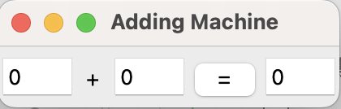
Widgets – Entry (2/2)
import tkinter as tk
def add():
n3.set(n1.get() + n2.get())
window = tk.Tk()
window.title('Adding Machine')
n1 = tk.IntVar()
n2 = tk.IntVar()
n3 = tk.IntVar()
ent1 = tk.Entry(window, width=4, textvariable=n1)
lbl = tk.Label(window, width=1, text='+')
ent2 = tk.Entry(window, width=4, textvariable=n2)
btn = tk.Button(window, width=1, text='=', command=add)
ent3 = tk.Entry(window, width=4, textvariable=n3)
ent1.grid(row=0, column=0, pady=5)
lbl.grid(row=0, column=1, pady=5, padx=3)
ent2.grid(row=0, column=2, pady=5)
btn.grid(row=0, column=3, pady=5)
ent3.grid(row=0, column=4, pady=5)
window.mainloop()
Notes:
jacky

Slide 9
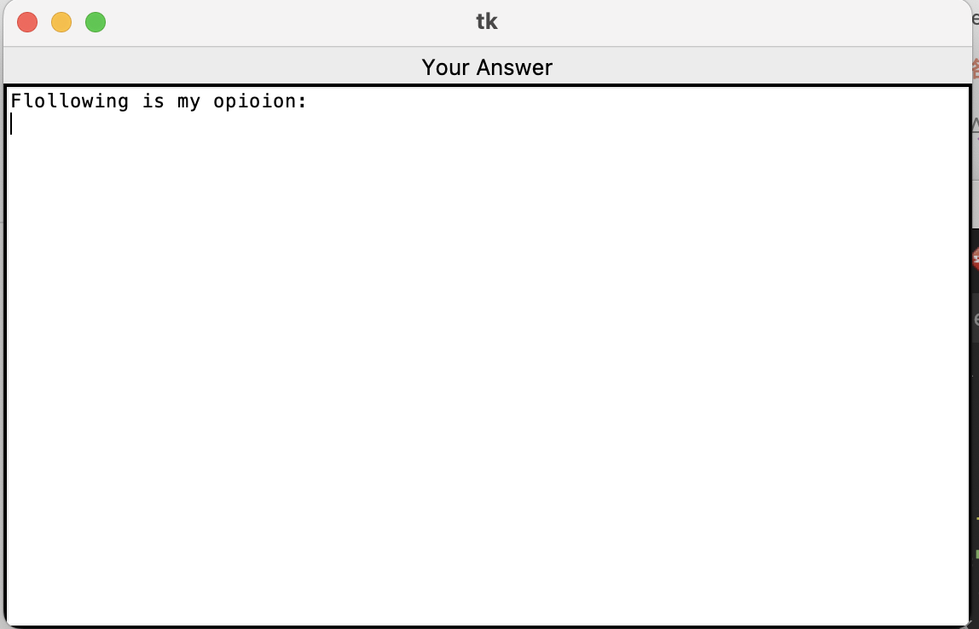
Widgets - Text
import tkinter as tk
# create window
window = tk.Tk()
#create widget (labels, button,..) – 元件
lbl = tk.Label(text="Your Answer")
txt_answer = tk.Text()
txt_answer.insert(tk.END, 'Flollowing is my opioion: \n')
#locate widgets by Geometry Managers – 幾何管理器
lbl.pack()
txt_answer.pack()
#initiate window
window.mainloop()
Notes:
？小提醒

Slide 10

Widgets - Frame
import tkinter as tk
# create window
window = tk.Tk()
#create widget (labels, button,..) – 元件
frame_a = tk.Frame(master=window, relief=tk.RAISED, borderwidth=5)
frame_b = tk.Frame()
label_a = tk.Label(master=frame_a, text="I'm in Frame A")
label_b = tk.Label(master=frame_b, text="I'm in Frame B")
#locate widgets by Geometry Managers – 幾何管理器
label_a.pack()
label_b.pack()
frame_a.pack()
frame_b.pack()
#initiate window
window.mainloop()
Relief options: tk.FLAT, tk.SUNKEN, tk.RAISED, tk.GROOVE, tk.RIDGE
Notes:
？小提醒

Slide 11
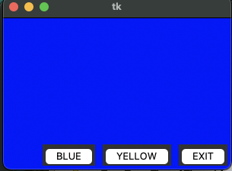
設定視窗背景顏色
def yellow():
window.config(bg='yellow')
def blue():
window.config(bg='blue')
import tkinter as tk
window = tk.Tk()
window.geometry('300x200')
btn_exit = tk.Button(window, text='EXIT', command=window.destroy)
btn_yellow = tk.Button(window, text='YELLOW', command=yellow)
btn_blue = tk.Button(window, text='BLUE', command=blue)
btn_exit.pack(anchor=tk.S, side=tk.RIGHT, padx=5, pady=5)
btn_yellow.pack(anchor=tk.S, side=tk.RIGHT, padx=5, pady=5)
btn_blue.pack(anchor=tk.S, side=tk.RIGHT, padx=5, pady=5)
window.mainloop()
Notes:
？小提醒

Slide 12

變數類別 (Variable Class)
Variable Class
IntVar()
DoubleVar()
StringVar()
BooleanVar()
import tkinter as tk
def btn_hit():
global msg_on
if not msg_on:
msg_on = True
x.set('tkinter is good')
else:
msg_on = False
x.set('')
# main program
window = tk.Tk()
msg_on = False
x = tk.StringVar()
lbl = tk.Label(window, textvariable=x,
bg='yellow', fg='black',)
btn = tk.Button(window, text='Click Me', command=btn_hit)
lbl.pack()
btn.pack()
window.mainloop()
Notes:
？小提醒

Slide 13
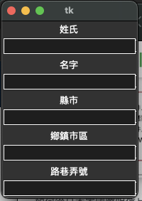
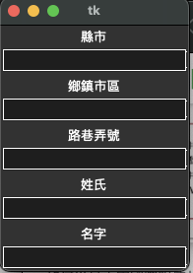
Lab# 信封資訊輸入 (#1)
創建兩個frame, 一個是地址的frame, 一個是姓名的frame
import tkinter as tk
# create window
…..
#create widget (labels, button,..) – 元件
frm_name = tk.Frame()
lbl_last_name = tk.Label(master=frm_name, text='姓氏')
ent_last_name = tk.Entry(master=frm_name)
……..
#locate widgets by Geometry Managers – 幾何管理器
lbl_last_name.pack()
…..
#initiate window
…..
frm_name.pack()
frm_address.pack()
frm_address.pack()
frm_name.pack()
Notes:
import tkinter as tk
# create window
window = tk.Tk()
#create widget (labels, button,..) – 元件
frm_name = tk.Frame()
frm_address = tk.Frame()
lbl_last_name = tk.Label(master=frm_name, text='姓氏')
lbl_first_name = tk.Label(master=frm_name, text='名字')
ent_last_name = tk.Entry(master=frm_name)
ent_first_name = tk.Entry(master=frm_name)
lbl_add_1 = tk.Label(master=frm_address, text="縣市")
lbl_add_2 = tk.Label(master=frm_address, text="鄉鎮市區")
lbl_add_3 = tk.Label(master=frm_address, text="路巷弄號")
ent_add_1 = tk.Entry(master=frm_address)
ent_add_2 = tk.Entry(master=frm_address)
ent_add_3 = tk.Entry(master=frm_address)
#locate widgets by Geometry Managers – 幾何管理器
lbl_last_name.pack()
ent_last_name.pack()
lbl_first_name.pack()
ent_first_name.pack()
lbl_add_1.pack()
ent_add_1.pack()
lbl_add_2.pack()
ent_add_2.pack()
lbl_add_3.pack()
ent_add_3.pack()
frm_address.pack()
frm_name.pack()
#initiate window
window.mainloop()

Slide 14
幾何管理器 (Geometry Manager) 控制版面配置
Pack()
會使用一種打包演算法，依照指定的順序把元件放進 Frame或視窗
計算一個稱為包裹（parcel）的矩形區域，高度（或寬度）剛好可以容納要放置的元件，然後再用空白填充包裏裡剩下的寬度（或高度）
預設會把 widgets 放在parcel的中心
Place()
多元件時使用困難
缺乏響應性, 不會隨著視窗大小改變而調整尺寸
Grid()
.grid（） 是一個很強大的幾何管理器, 運作方式是把視窗或 frame 拆分為網格狀的列和欄
通常會比 pack() 更方便使用，又比 place() 靈活得多. 在設計 Tkinter 應用程式的時候，可以考慮優先使用 grid() 作為主要的幾何管理器

Slide 15
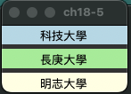
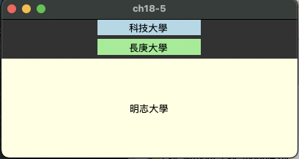

Pack()
import tkinter as tk
window = tk.Tk()
window.title('ch18-5')
lbl1 = tk.Label(window,
text='明志大學',
bg='lightyellow',
width=15,)
lbl2 = tk.Label(window,
text='長庚大學',
bg='lightgreen',
width=15)
lbl3 = tk.Label(window,
text='科技大學',
bg='lightblue',
width=15)
lbl1.pack()
lbl2.pack(side=tk.RIGHT)
lbl3.pack(side=tk.LEFT)
window.mainloop()
import tkinter as tk
import tkinter as tk
window = tk.Tk()
window.title('ch18-5')
lbl1 = tk.Label(window,
text='明志大學',
fg='black',
bg='lightyellow',
width=15,)
lbl2 = tk.Label(window,
text='長庚大學',
fg='black',
bg='lightgreen',
width=15)
lbl3 = tk.Label(window,
text='科技大學',
fg='black',
bg='lightblue',
width=15)
lbl1.pack(side=tk.BOTTOM, fill=tk.BOTH, expand=True)
lbl2.pack(side=tk.BOTTOM, pady=5)
lbl3.pack(side=tk.BOTTOM)
window.mainloop()
side = tk.TOP, tk.BOTTOM, tk.LEFT, tk.RIGHT
padx, pady
fill = tk.X, tk.Y, tk.BOTH
expand = True

Slide 16

Grid()
import tkinter as tk
window = tk.Tk()
lbl1 = tk.Label(window,
text='明志大學',
bg='lightyellow',
width=15,)
lbl2 = tk.Label(window,
text='長庚大學',
bg='lightgreen',
width=15)
lbl3 = tk.Label(window,
text='科技大學',
bg='lightblue',
width=15)
lbl4 = tk.Label(window,
text='交通大學',
bg='red',
width=15)
lbl1.grid(row=0, column=0, columnspan=2, sticky='w')
lbl2.grid(row=1, column=0)
lbl3.grid(row=1, column=1)
lbl4.grid(row=2, column=0, columnspan=2, sticky='we')
sticky = 'n', 's', 'e', 'w', 'ns', 'ew', 'nsew'

Slide 17
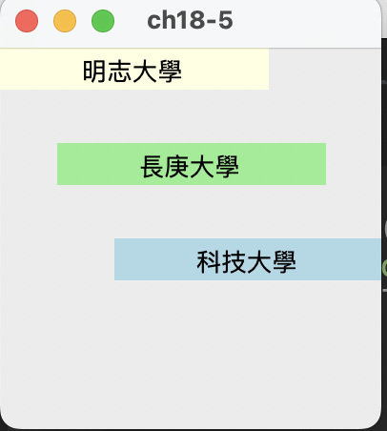
Place()
import tkinter as tk
window = tk.Tk()
window.title('ch18-5')
lbl1 = tk.Label(window,
text='明志大學',
bg='lightyellow',
width=15,)
lbl2 = tk.Label(window,
text='長庚大學',
bg='lightgreen',
width=15)
lbl3 = tk.Label(window,
text='科技大學',
bg='lightblue',
width=15)
lbl1.place(x=0, y=0)
lbl2.place(x=30, y=50)
lbl3.place(x=60, y=100)
window.mainloop()

Slide 18
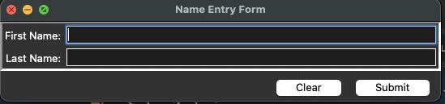
Lab# 輸入姓名資料
import tkinter as tk
def clear_click():
ent_first_name.delete(0, tk.END)
ent_last_name.delete(0, tk.END)
def submit_click():
print(f'Last Name: {ent_last_name.get()}\nFirst Name: {ent_first_name.get()}')
# create window
window = tk.Tk()
#create widget (labels, button,..) – 元件
frm_name = tk.Frame()
lbl_last_name = tk.Label(master=frm_name, text='Last Name')
ent_last_name = tk.Entry(master=frm_name)
lbl_first_name = tk.Label(master=frm_name, text='First Name')
ent_first_name = tk.Entry(master=frm_name)
# create button frame
frm_button = tk.Frame()
btn_clear = tk.Button(master=frm_button, text='Clear', command=clear_click)
btn_submit = tk.Button(master=frm_button, text='Submit', command=submit_click)
#locate widgets by Geometry Managers – 幾何管理器
lbl_last_name.grid(row=0, column=0)
ent_last_name.grid(row=0, column=1)
lbl_first_name.grid(row=1, column=0)
ent_first_name.grid(row=1, column=1)
frm_name.pack()
btn_clear.grid(row=0, column=0)
btn_submit.grid(row=0, column=1)
frm_button.pack()
#initiate window
window.mainloop()

Slide 19
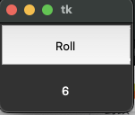
Lab# 擲骰子
import tkinter as tk
import random
#define action
def roll():
num = random.randint(1,6)
lbl_result['text']=str(num)
#create window
window = tk.Tk()
window.rowconfigure([0,1], minsize=50)
window.columnconfigure(0, minsize=150)
# add button and label
btn_roll = tk.Button(text='Roll', command=roll)
lbl_result = tk.Label()
# put button and label
btn_roll.grid(row=0, column=0, sticky='nsew')
lbl_result.grid(row=1, column=0, sticky='nsew')
# initializing window
window.mainloop()

Slide 20
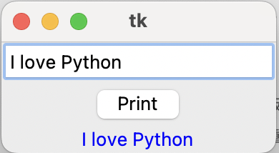
Lab# Get String from Entry Widget
Create a window having an entry widget, type ‘I love Python’, click Print button to print the string to a label.
import tkinter as tk
#define action
def print_content():
lbl_result['text']=ent_input.get()
#create window
window = tk.Tk()
# add entry, button and label
ent_input = tk.Entry()
btn_print = tk.Button(text='Print', command=print_content)
lbl_result = tk.Label(fg='blue')
# put entry, button and label
ent_input.pack()
btn_print.pack()
lbl_result.pack()
# initializing window
window.mainloop()
Notes:
import tkinter as tk
# create window
window = tk.Tk()
#create widget (labels, button,..) – 元件
lbl_1 = tk.Label(text='GUI is great!')
lbl_2 = tk.Label(text='Python rocks!')
lbl_3 = tk.Label(text='Engage!')
#locate widgets by Geometry Managers – 幾何管理器
lbl_1.pack()
lbl_2.pack()
lbl_3.pack()
#initiate window
window.mainloop()

Slide 21
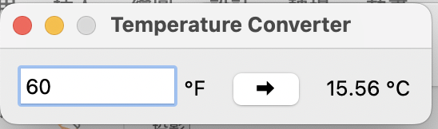
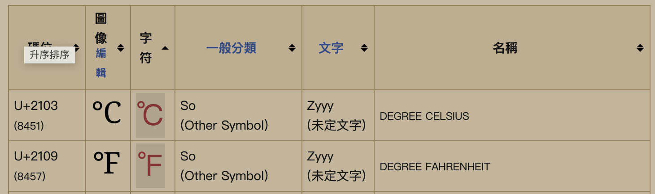
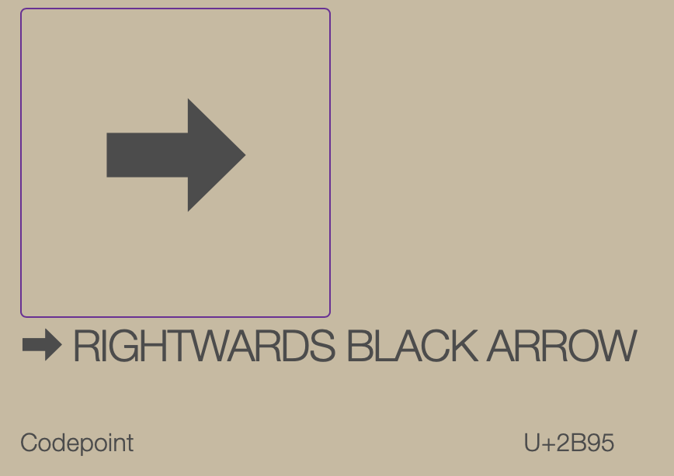
Lab# Temperature Converter
import tkinter as tk
# def button click function
def fahrenheit_to_celsius():
fahrenheit = ent_temperature.get()
celsius = (5 / 9) * (float(fahrenheit) - 32)
lbl_result["text"] = f"{round(celsius, 2)} \N{DEGREE CELSIUS}"
# Set up the window
window = tk.Tk()
window.title("Temperature Converter")
# Create the Fahrenheit entry frame with an Entry and Label in it
frm_entry = tk.Frame(master=window)
ent_temperature = tk.Entry(master=frm_entry, width=10)
lbl_temp = tk.Label(master=frm_entry, text="\N{DEGREE FAHRENHEIT}")
# Layout the temperature Entry and Label in frm_entry using the .grid() geometry manager
ent_temperature.grid(row=0, column=0, sticky="e")
lbl_temp.grid(row=0, column=1, sticky="w")
# Create the conversion Button and result display Label
btn_convert = tk.Button(
master=window, text="\N{RIGHTWARDS BLACK ARROW}", command=fahrenheit_to_celsius)
lbl_result = tk.Label(master=window, text="\N{DEGREE CELSIUS}")
# Set up the layout using the .grid() geometry manager
frm_entry.grid(row=0, column=0, padx=10)
btn_convert.grid(row=0, column=1, pady=10)
lbl_result.grid(row=0, column=2, padx=10)
# Run the application
window.mainloop()
Entry: ent_temperature for entering the Fahrenheit value
Label: lbl_result to display the Celsius result
Button: btn_convert that reads the value from the Entry widget, converts it from Fahrenheit to Celsius, and sets the text of the Label widget to the result when clicked
https://zh.wiktionary.org/zh-hant/Appendix:Unicode/%E5%AD%97%E6%AF%8D%E5%BC%8F%E7%AC%A6%E8%99%9F
Notes:
import tkinter as tk
# create window
window = tk.Tk()
#create widget (labels, button,..) – 元件
lbl_1 = tk.Label(text='GUI is great!')
lbl_2 = tk.Label(text='Python rocks!')
lbl_3 = tk.Label(text='Engage!')
#locate widgets by Geometry Managers – 幾何管理器
lbl_1.pack()
lbl_2.pack()
lbl_3.pack()
#initiate window
window.mainloop()

Slide 22
Backup

Slide 23
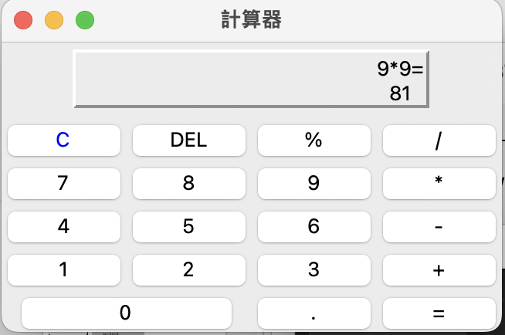
Lab# Calculator
from tkinter import *
def calculate(): # 執行計算並顯示結果
result = eval(equ.get())
equ.set(equ.get() + "=\n" + str(result))
def show(buttonString): # 更新顯示區的計算公式
content = equ.get()
if content == "0":
content = ""
equ.set(content + buttonString)
def backspace(): # 刪除前一個字元
equ.set(str(equ.get()[:-1]))
def clear(): # 清除顯示區,放置0
equ.set("0")
root = Tk()
root.title("計算器")
equ = StringVar()
equ.set("0") # 預設是顯示0
# 設計顯示區
label = Label(root,width=25,height=2,relief="raised",anchor=SE, textvariable=equ)
label.grid(row=0,column=0,columnspan=4,padx=5,pady=5)
# 清除顯示區按鈕
clearButton = Button(root,text="C",fg="blue",width=5,command=clear)
clearButton.grid(row = 1, column = 0)
# 以下是row1的其它按鈕
Button(root,text="DEL",width=5,command=backspace).grid(row=1,column=1)
Button(root,text="%",width=5,command=lambda:show("%")).grid(row=1,column=2)
Button(root,text="/",width=5,command=lambda:show("/")).grid(row=1,column=3)
# 以下是row2的其它按鈕
Button(root,text="7",width=5,command=lambda:show("7")).grid(row=2,column=0)
Button(root,text="8",width=5,command=lambda:show("8")).grid(row=2,column=1)
Button(root,text="9",width=5,command=lambda:show("9")).grid(row=2,column=2)
Button(root,text="*",width=5,command=lambda:show("*")).grid(row=2,column=3)
# 以下是row3的其它按鈕
Button(root,text="4",width=5,command=lambda:show("4")).grid(row=3,column=0)
Button(root,text="5",width=5,command=lambda:show("5")).grid(row=3,column=1)
Button(root,text="6",width=5,command=lambda:show("6")).grid(row=3,column=2)
Button(root,text="-",width=5,command=lambda:show("-")).grid(row=3,column=3)
# 以下是row4的其它按鈕
Button(root,text="1",width=5,command=lambda:show("1")).grid(row=4,column=0)
Button(root,text="2",width=5,command=lambda:show("2")).grid(row=4,column=1)
Button(root,text="3",width=5,command=lambda:show("3")).grid(row=4,column=2)
Button(root,text="+",width=5,command=lambda:show("+")).grid(row=4,column=3)
# 以下是row5的其它按鈕
Button(root,text="0",width=12, command=lambda:show("0")).grid(row=5,column=0,columnspan=2)
Button(root,text=".",width=5, command=lambda:show(".")).grid(row=5,column=2)
Button(root,text="=",width=5,bg ="yellow", command=lambda:calculate()).grid(row=5,column=3)
root.mainloop()
Notes:
import tkinter as tk
# create window
window = tk.Tk()
#create widget (labels, button,..) – 元件
lbl_1 = tk.Label(text='GUI is great!')
lbl_2 = tk.Label(text='Python rocks!')
lbl_3 = tk.Label(text='Engage!')
#locate widgets by Geometry Managers – 幾何管理器
lbl_1.pack()
lbl_2.pack()
lbl_3.pack()
#initiate window
window.mainloop()

Slide 24
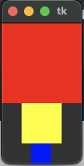
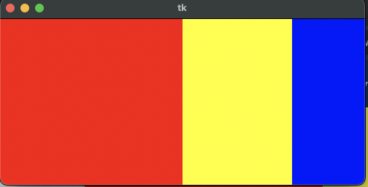
Pack()
import tkinter as tk
window = tk.Tk()
frame1 = tk.Frame(master=window, width=100, height=100, bg="red")
frame1.pack()
frame2 = tk.Frame(master=window, width=50, height=50, bg="yellow")
frame2.pack()
frame3 = tk.Frame(master=window, width=25, height=25, bg="blue")
frame3.pack()
window.mainloop()
import tkinter as tk
window = tk.Tk()
frame1 = tk.Frame(master=window, width=200, height=100, bg="red")
frame1.pack(fill=tk.BOTH, side=tk.LEFT, expand=True)
frame2 = tk.Frame(master=window, width=100, bg="yellow")
frame2.pack(fill=tk.BOTH, side=tk.LEFT, expand=True)
frame3 = tk.Frame(master=window, width=50, bg="blue")
frame3.pack(fill=tk.BOTH, side=tk.LEFT, expand=True)
window.mainloop()

Slide 25

Grid()
import tkinter as tk
window = tk.Tk()
window.rowconfigure(0, minsize=50)
window.columnconfigure([0, 1, 2, 3], minsize=50)
label1 = tk.Label(text='1', bg='red', fg='white')
label2 = tk.Label(text='2', bg='yellow', fg='white')
label3 = tk.Label(text='3', bg='blue', fg='white')
label4 = tk.Label(text='4', bg='black', fg='white')
label1.grid(row=0, column=0)
label2.grid(row=0, column=1, sticky='ew')
label3.grid(row=0, column=2, sticky='ns')
label4.grid(row=0, column=3, sticky='nsew')
window.mainloop()
sticky = 'n', 's', 'e', 'w', 'ns', '

